Slide 1

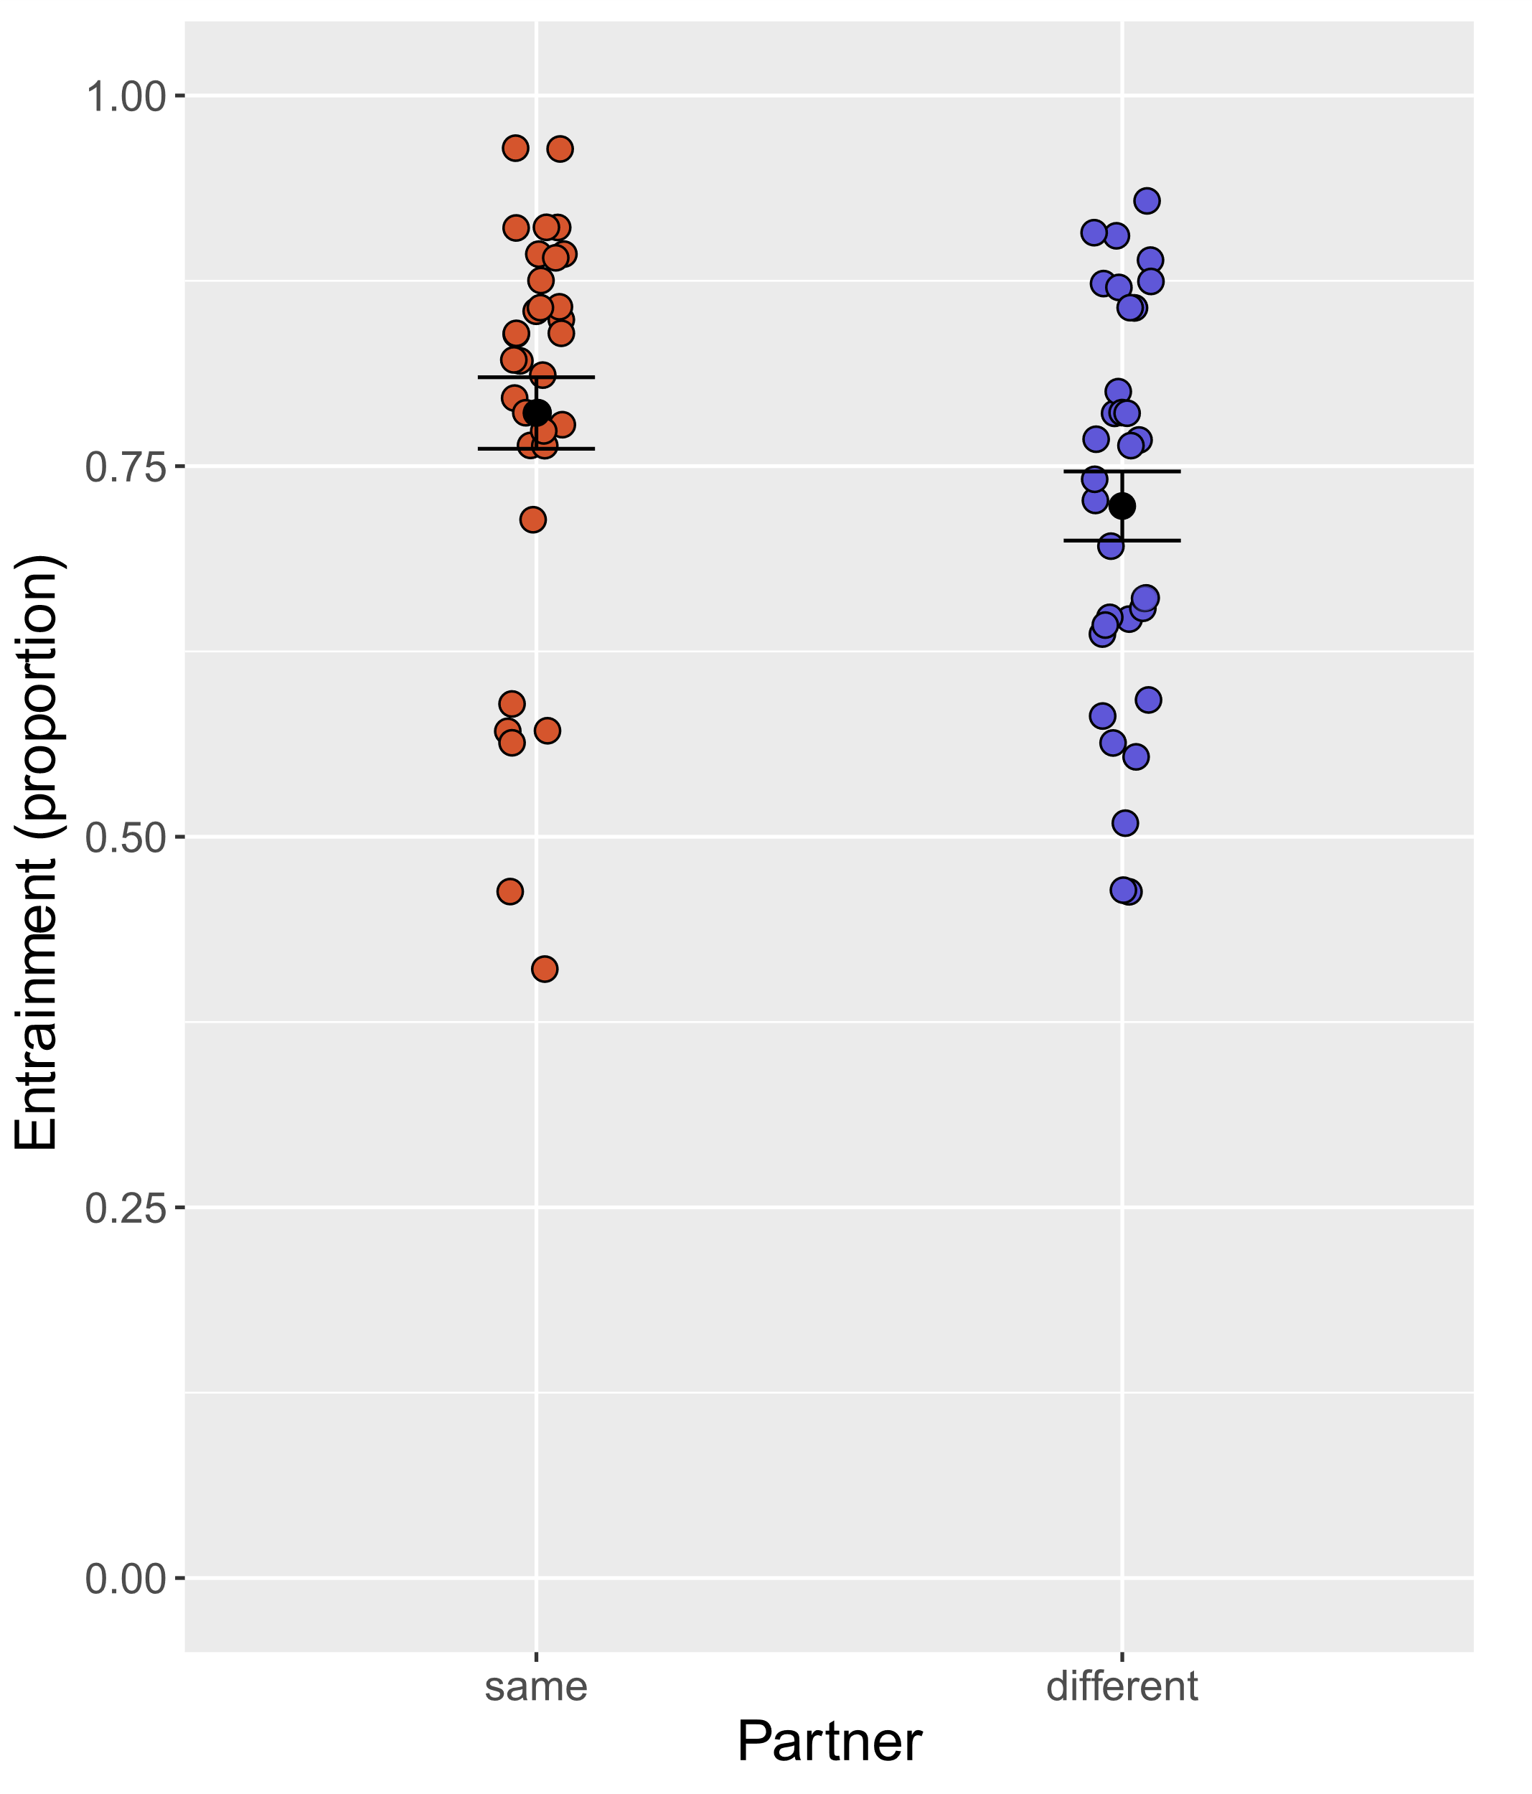
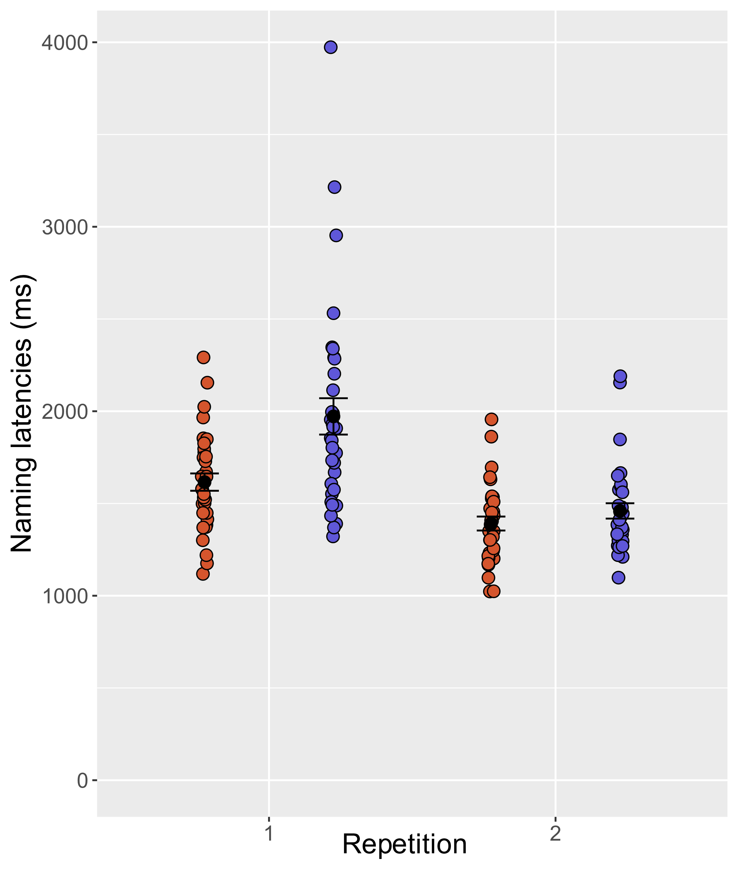



















Lexical access in dialogue: recency effects or partner-specific adaptations?
Isabella P. Boux, Anna K. Kuhlen
Institute of Psychology, RWTH University Aachen, Germany
INTRODUCTION
RESULTS
When people interact with each other in dialogue, they tend to lexically entrain with one another (Brennan & Clark, 1996; Garrod & Anderson, 1987; Metzing & Brennan, 2003). Two accounts have been proposed to explain this phenomenon:
The recency account (Pickering & Garrod, 2004; Barr & Keysar 2002): entrainment is the result of basic recency effects: if a word has been used recently it is more likely to be reused again.
The partner-adapted account (Brennan et al., 2010): besides recency, entrainment is the outcome of a “conceptual pact” between interlocutors resulting in a partner-specific facilitation of lexical-semantic access.
Horton & Gerrig (2005) showed that speaking was facilitated when a complex expression was produced for the partner it was entrained with vs. a different partner.
► Hypotheses
Our goal was to investigate partner-specific lexical entrainment in speech production (see Horton & Gerrig, 2005) but using exact chronometric measures of lexical access. We predict that using entrained labels with same vs. different partners facilitates lexical access leading to:
higher entrainment maintenance
shorter naming latencies
► Entrainment (Fig. 2)
A repeated measures ANOVA showed that subjects were more likely to maintain the entrained label when naming the tangram for the same vs. different partner (F(1, 32)=6.109. p=0.019, η²_{p}=0.160) as in the training. This was the case for both repetitions.
*
Fig. 2: Proportion of entrained labels maintained during the test phase, as a function of partner (same vs. different).
► Naming latency (Fig. 3)
A repeated measures ANOVA showed that subjects were faster at producing the previously used label when naming the tangram for the same vs. different partner, as shown by a significant interaction effect between partner and round (F(1,32)=13.3, p<0.001, η²_{p}=0.294). This was the case only in the first repetition round (p_{Bonf}<0.001). The effect was absent in the second repetition (p_{Bonf} <0.138).
MATERIALS AND METHODS
Thirty-three adult subjects took part to a modified director-matcher task with two different partners (confederates). Subject and partner could hear each other but could not see each other screens. They were instructed to play a game as a team, where they would have to get the matcher to identify certain figures as quickly and accurately as possible.
► Partner-specific entrainment phase (3 repetitions x 2 partners)
The partner named certain tangram figures with a single specified label (unbeknownst to the subject).
The subject saw an array of tangrams on their screen and needed to find the named tangram.
► Test phase (2 repetitions x 2 partners)
The partner-specificity of the lexical entrainment was probed.
The subject saw individual tangrams on their screen and named them for the partner.
The partner saw an array of tangrams on their screen and needed to find the named tangram.
Some tangrams were named in interaction with the same partner as in the entrainment phase, other in presence of the different partner.
***
ns
Fig. 3: Naming latencies during the test phase, as a function of partner (same vs. different) and repetition (1 vs. 2).
CONCLUSION
People are more likely to stick to a label and are faster at producing it when interacting with the same (vs. different) partner they have previously entrained with.
► Partner-specific vs. recency effects: These results are consistent with previous studies indicating that entrainment can be partner-specific (Horton & Gerrig, 2005, Metzing & Brennan, 2003) and that it is not merely the result of recency.
► Partner as a cue for accessing prior experience: These results are consistent with previous studies indicating that a specific partner can act as a cue facilitating lexical access (Horton & Gerrig, 2005, Horton, 2007, but see Brown-Schmidt & Horton 2014).
► Outlook: Future studies might use EEG to investigate the neurophysiological processes and time course of lexical access during partner-adapted speech production.
PARTNER-SPECIFIC
ENTRAINMENT
TEST
A
A
B
B
Fig. 1: Schematic representation of the partner-specific entrainment phase and the test phase. Half of the items in the test phase are produced for the same partner as in the training phase. The other half was produced for the other (different) partner.
References: Barr, D. J., & Keysar, B. (2002). Anchoring comprehension in linguistic precedents. Journal of Memory and Language, 46(2), 391-418. | Brennan, S. E., & Clark, H. H. (1996). Conceptual pacts and lexical choice in conversation. Journal of Experimental Psychology. Learning, Memory, and Cognition, 22(6), 1482–1493. | Brennan, S. E., Galati, A., & Kuhlen, A. K. (2010). Two Minds, One Dialog: Coordinating Speaking and Understanding. In B. H. Ross (Ed.), Psychology of Learning and Motivation (Vol. 53, pp. 301–344). Academic Press. | Brown-Schmidt, S., & Horton, W. S. (2014). The influence of partner-specific memory associations on picture naming: A failure to replicate Horton (2007). PloS one, 9(10), e109035. | Garrod, S., & Anderson, A. (1987). Saying what you mean in dialogue: A study in conceptual and semantic co-ordination. Cognition, 27(2) | Horton, W. S., & Gerrig, R. J. (2005). The impact of memory demands on audience design during language production. Cognition, 96(2), 127-142. | Metzing, C., & Brennan, S. E. (2003). When conceptual pacts are broken: Partner-specific effects on the comprehension of referring expressions. Journal of Memory and Language, 49(2), 201–213. | Pickering, M. J., & Garrod, S. (2004). Toward a mechanistic psychology of dialogue. Behavioral and Brain Sciences, 27(02), 169–225.

